Slide 1
Hepatocellular Carcinoma Detection Using Gene expression
LR - LDA/QDA - LASSO - RF - hierarchical/kmeans clustering - PCA - SVM

Slide 2
TABLE OF CONTENTS
01
02
03
Genes selection
Supervised techniques
Unsupervised techniques
>22000 genes
Variance-based
RandomForest-based
LR - LASSO
LDA - QDA
RF - Bagging - Trees
SVM
K-means clustering
Hierarchical clustering
PCA

Slide 3
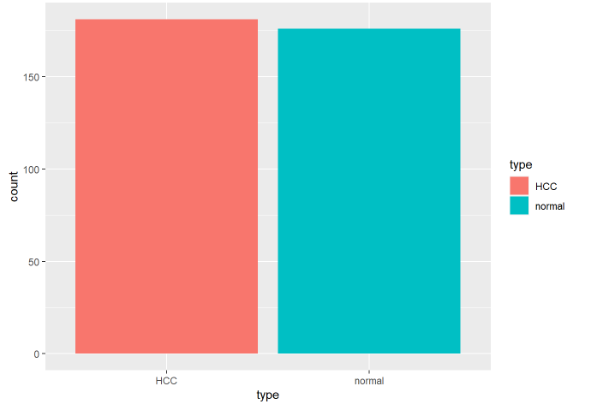
About the data
Microarray of genes expression
curated from 30.000 studies from GEO
Unnormalized
2 classes (HCC - normal)
357 cases
50:50 HCC / normal cases

Slide 4
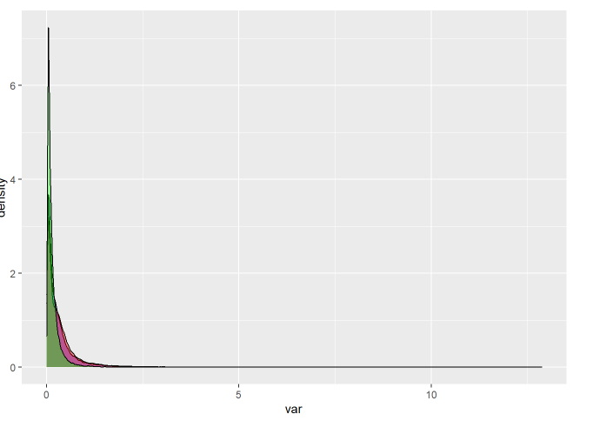
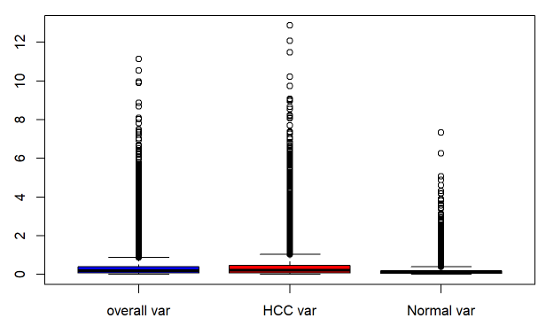
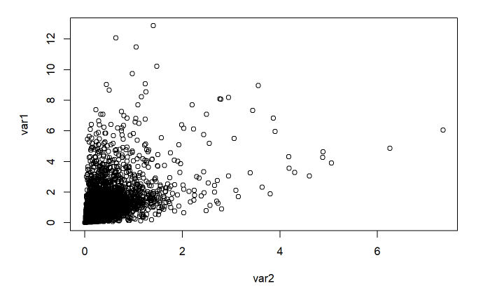
Highest-Variance Selection Approach
Green - variance over HCC cases
(var1)
27 genes selected
Red - variance over normal cases
(var2)

Slide 5
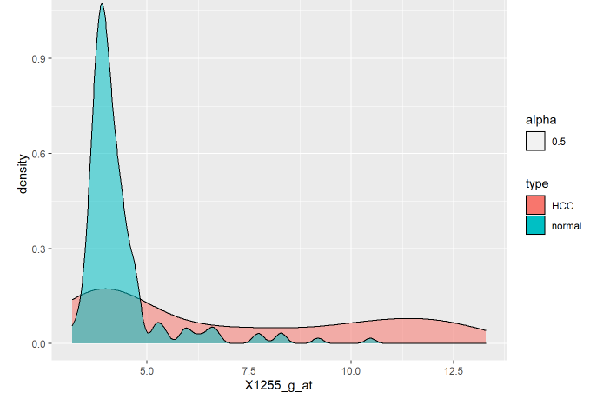
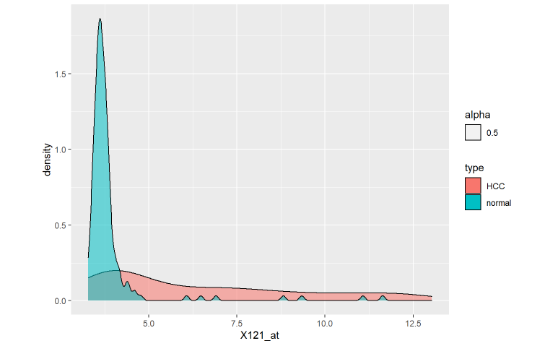
Selected genes examination
Separation disturbances

Slide 6
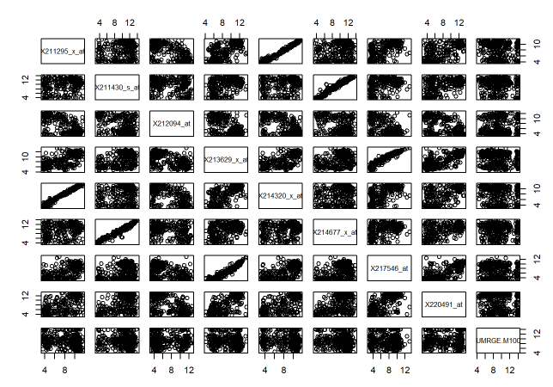
Strong correlations between selected genes

Slide 7
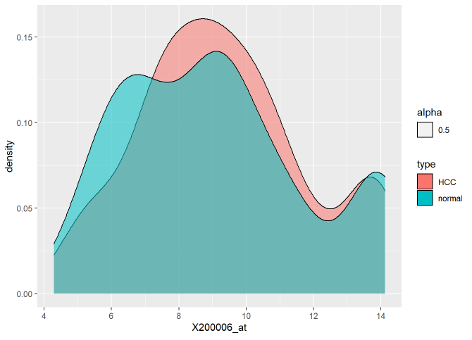
Selected genes with almost no separation potential

Slide 8
Upon elimination of the irrelevant genes selected using this approach, an efficient LR model was built using 5 genes only
Null deviance - 494
Residual deviance - 83
AIC - 95
Training accuracy - 96%
Testing accuracy - 89%

Slide 9
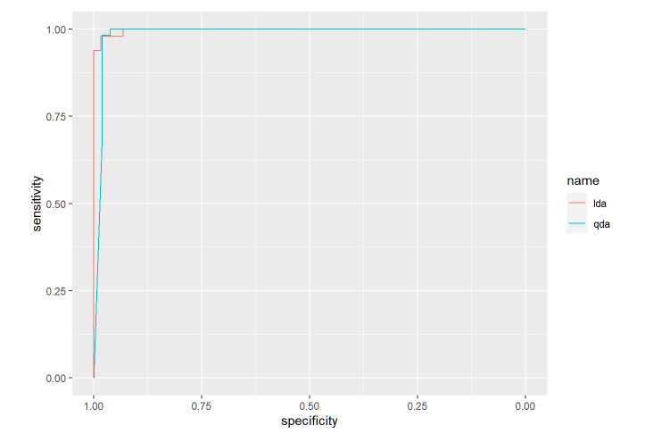
LDA - QDA

Slide 10
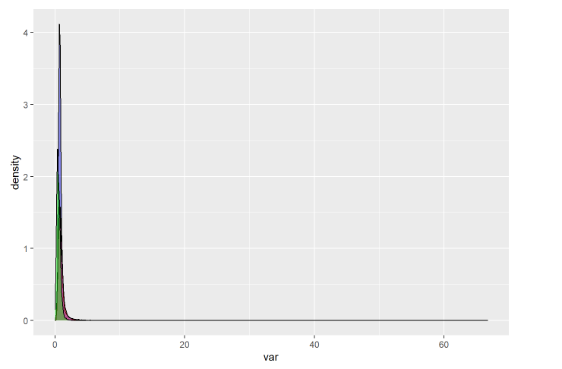
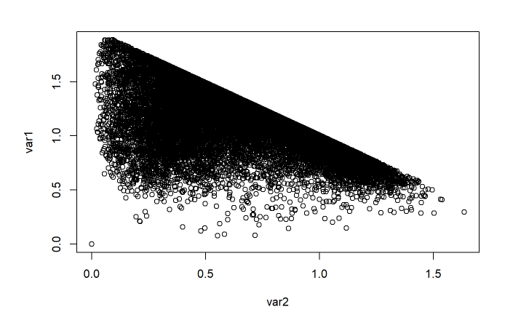
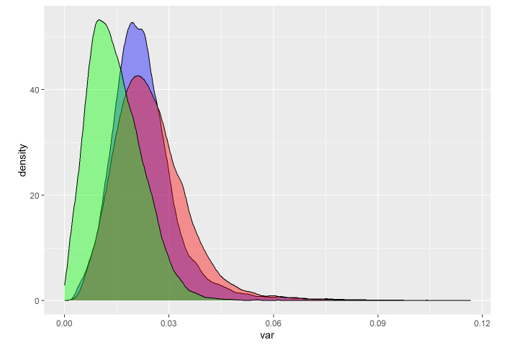
Data Normalization
Standardization -> mean=0 ; sd=1
Min-max -> min=0 ; max=1
Robust scalar -> median=0
*Normalization will not affect the data distribution, nor the model accuracy, yet it will change the coefficients rendering them more interpretable.

Slide 11
II. The Boruta RF-based selection approach
Creation of the shadow features
(by shuffling the values to remove their correlations)
Random Forest Creation
Features classification based on shadow max (the max z-value)
Importance scores (for features) & z scores (for shadow features) computation
*Important - above shadow min (better than the best randomized (shadow) feature)
*Tentative - close to it
*Unimportant - significantly below it
Relying on the Mean Decrease Accuracy approach (how much accuracy the model loses by excluding each feature)

Slide 12
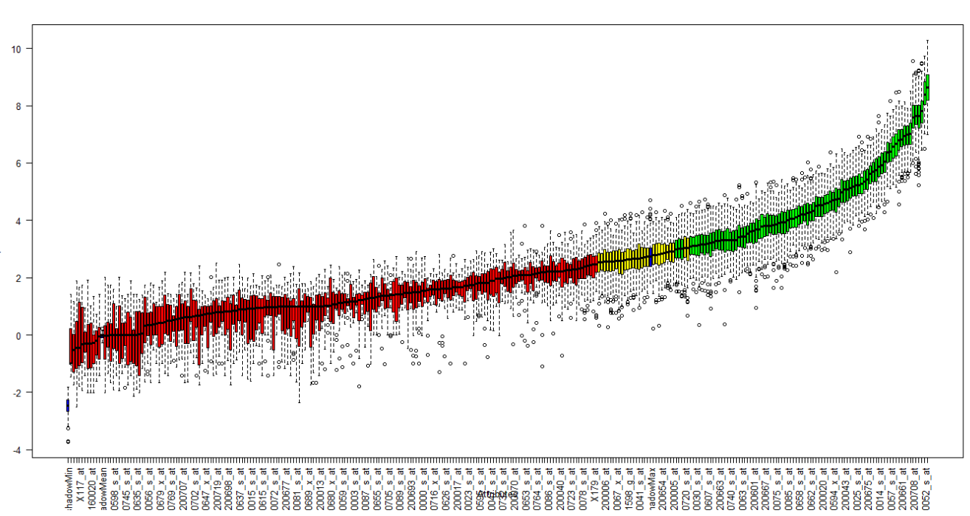

Slide 13
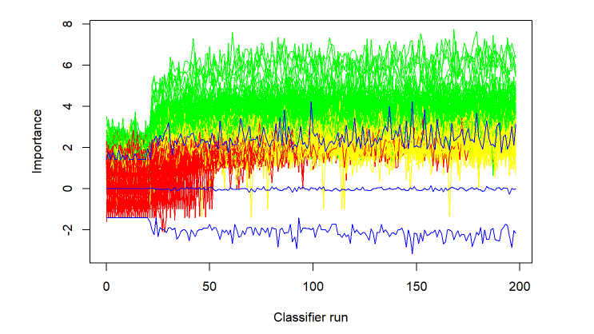
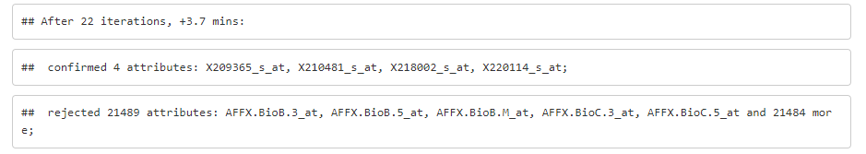

Slide 14
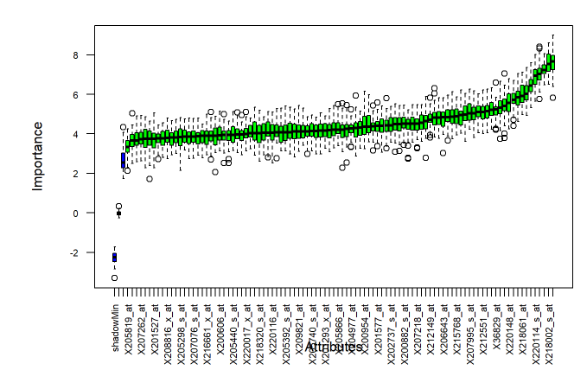
A dataset as created using the 98 genes classified as important

Slide 15
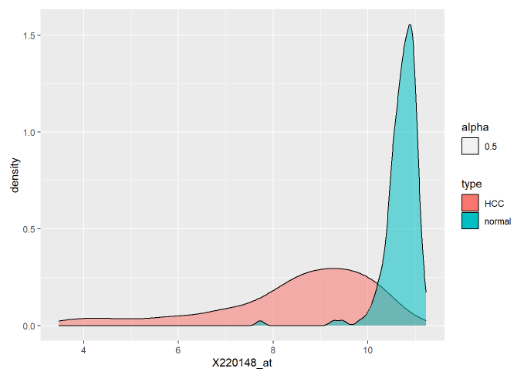
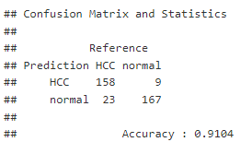
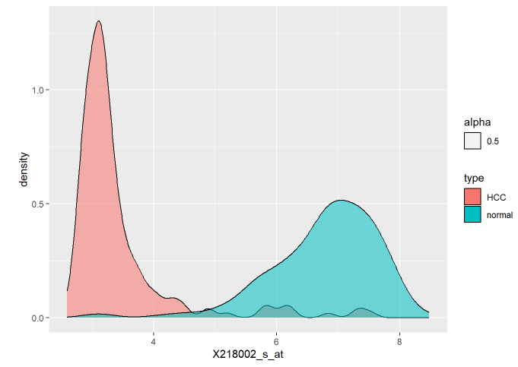
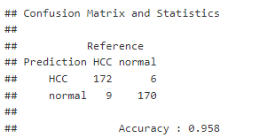
AIC: 169.22
AIC: 108.37

Slide 16
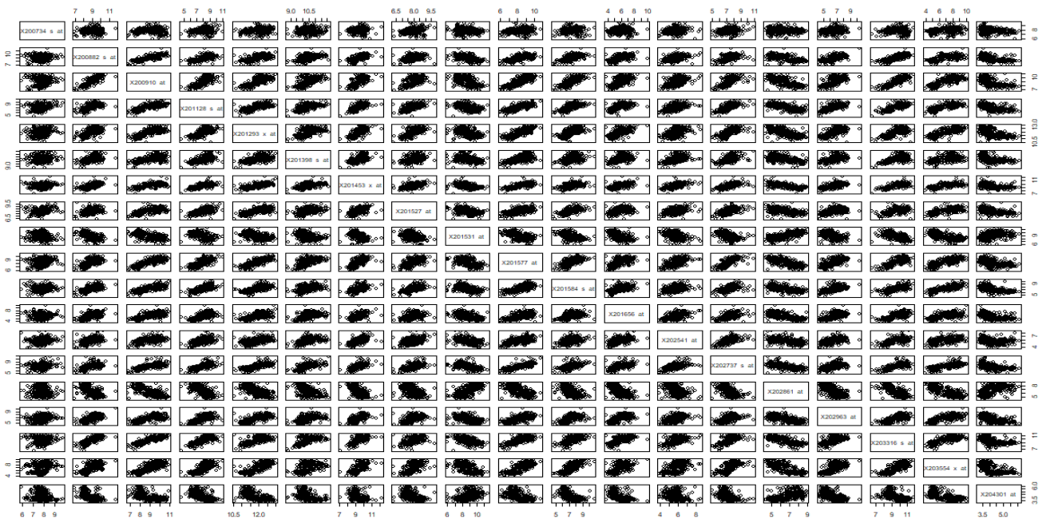

Slide 17
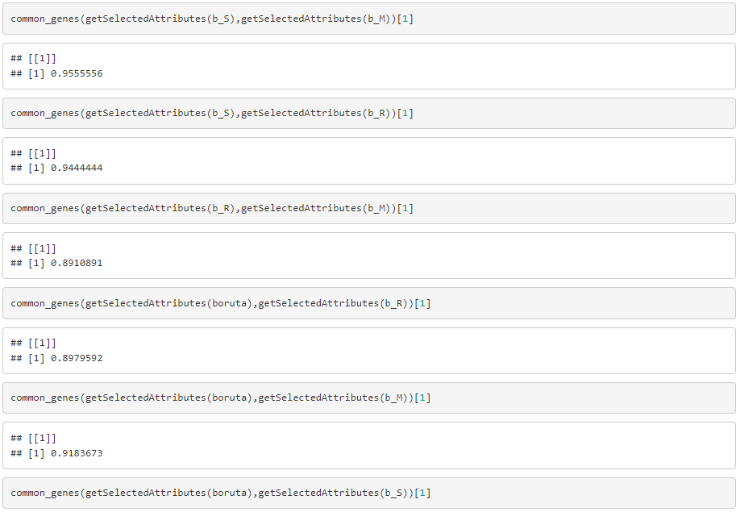
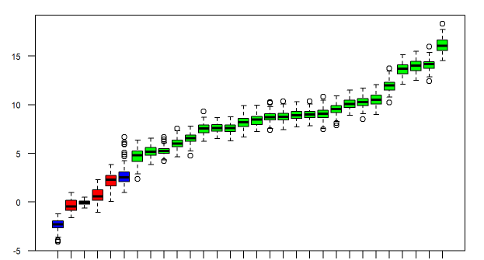
Normalization effect
Evaluating the efficiency of I
0.125 -> 0.08
Further decrease in the number of important selected genes if bias is introduced by considering variances across classes
0.545 for biased selection on the standardized dataset

Slide 18
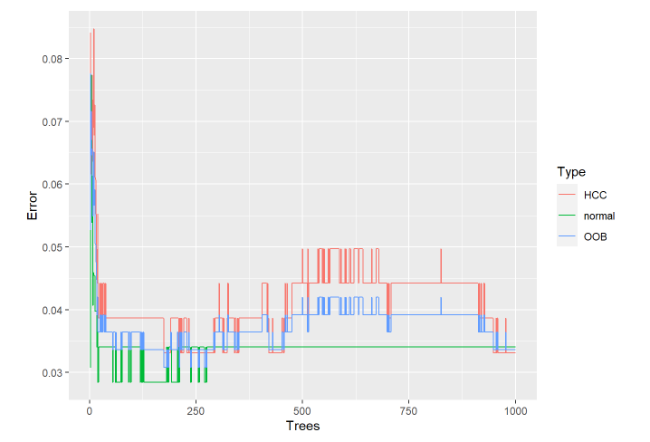
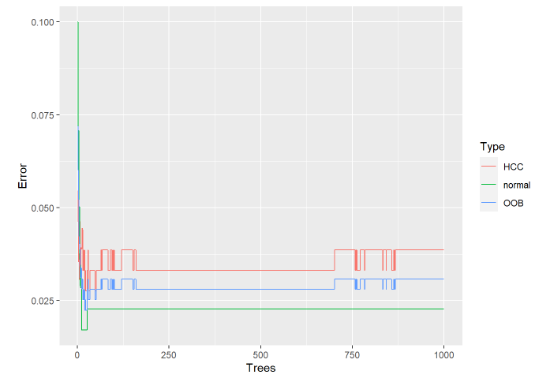
Random Forest - Bagging

Slide 19
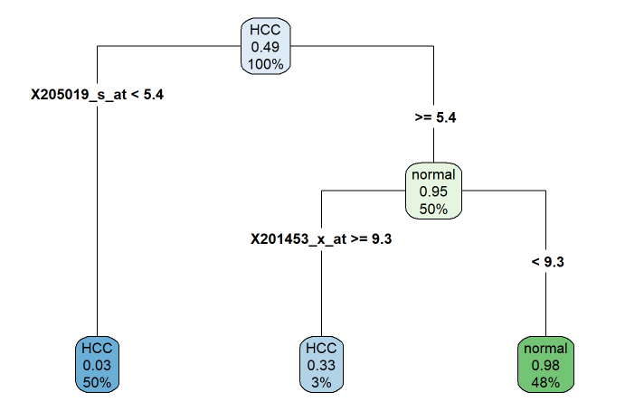
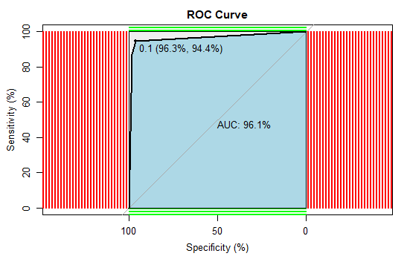
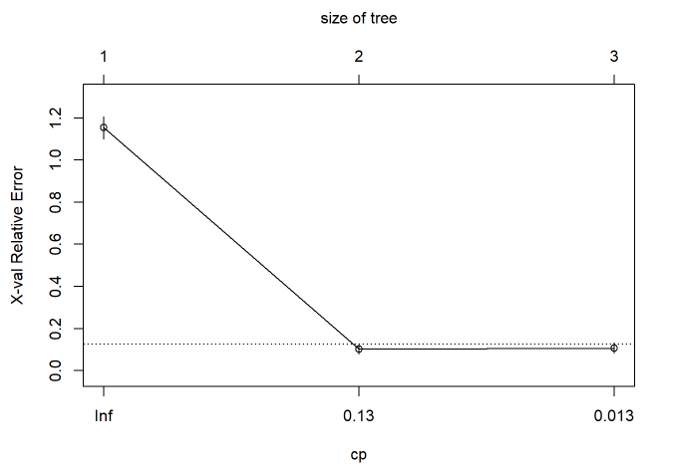
Classification trees

Slide 20
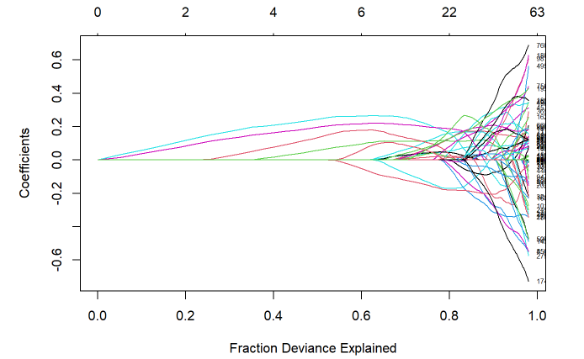
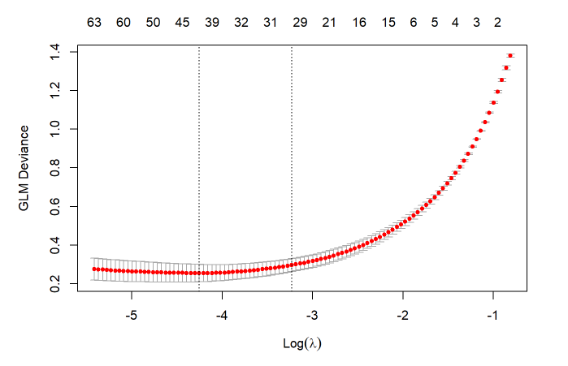
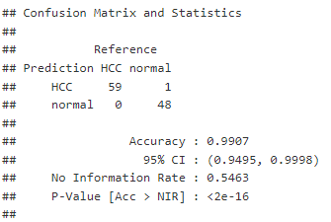
LASSO
Efficient for dealing with correlations and the high number of features

Slide 21
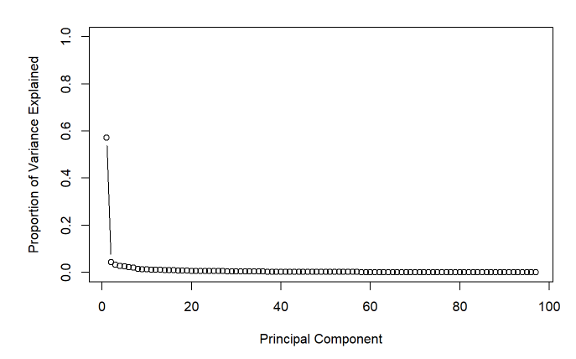
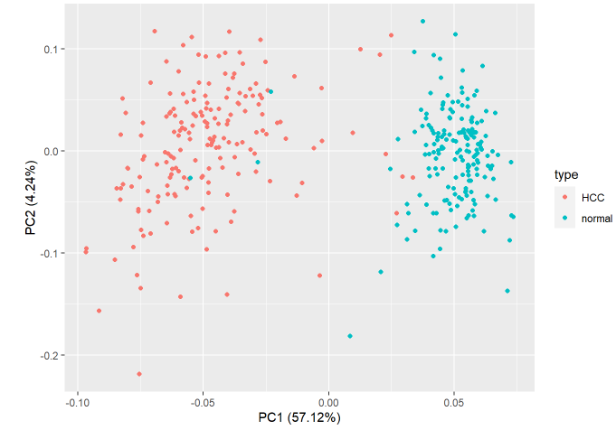
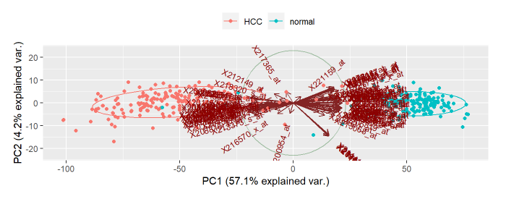
PCA

Slide 22
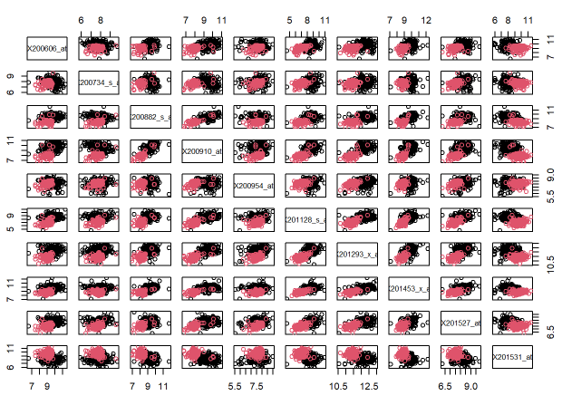
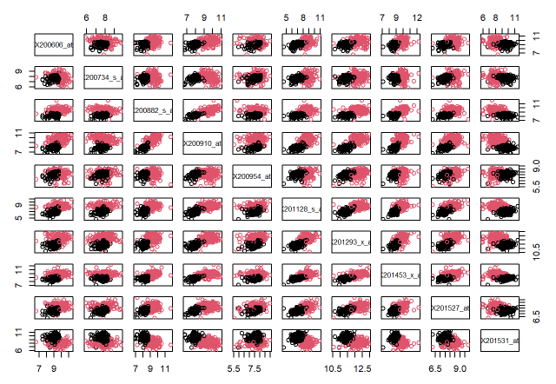
K-means clustering
Colored by cluster
Colored by actual category
96% similarity

Slide 23
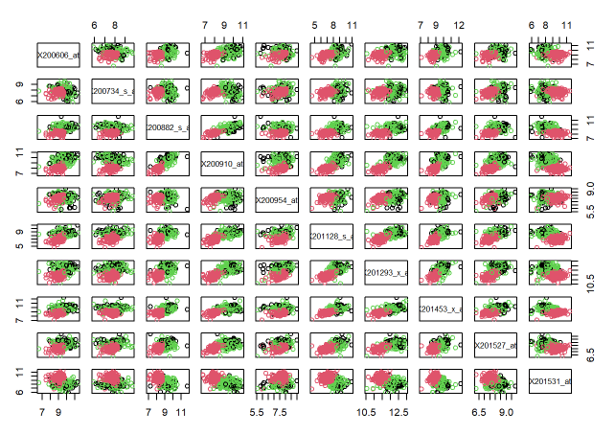
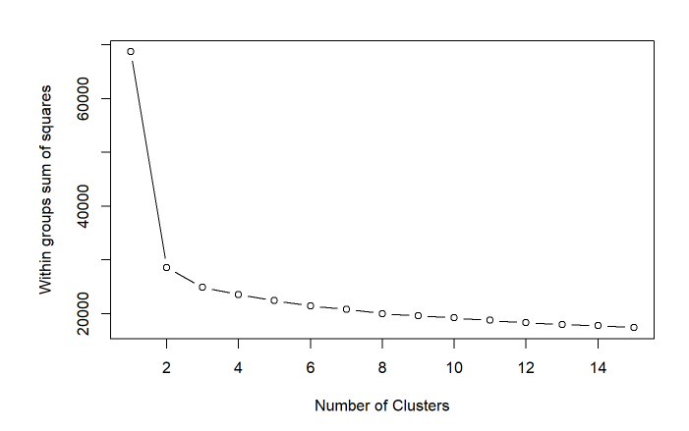
2 clusters representative of 1 class

Slide 24
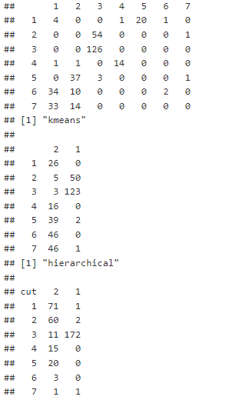
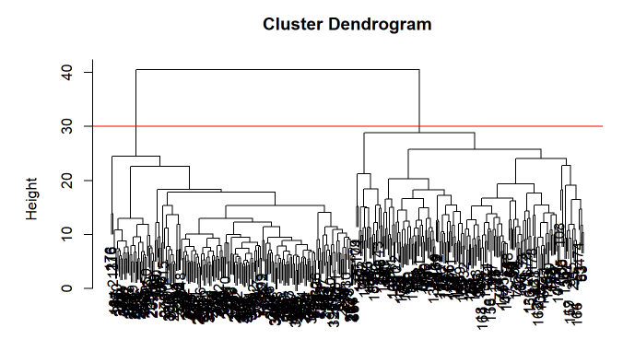
Hierarchical clustering

Slide 25
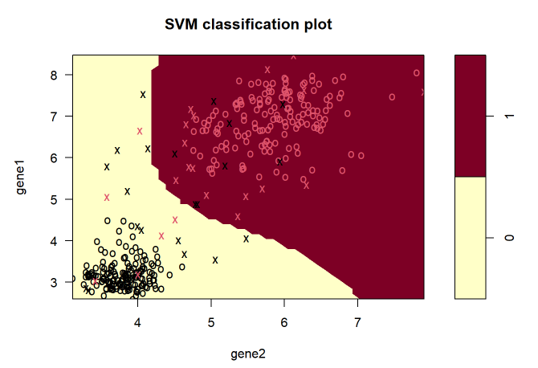
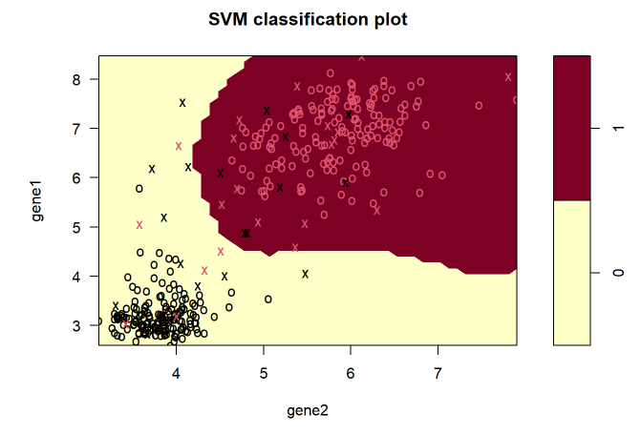
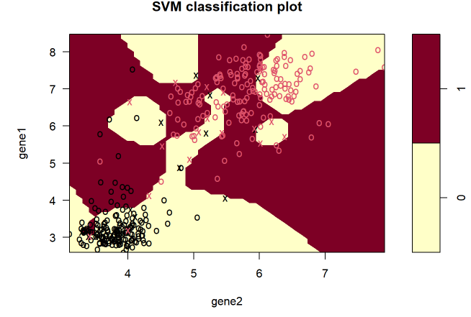
SVM
C = 2
C = 100
C = 1000000
Number of support vectors decrease, and misclassifications increase (increase in bias)

Slide 26
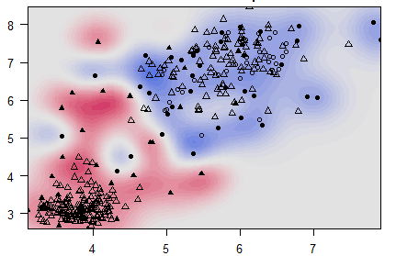
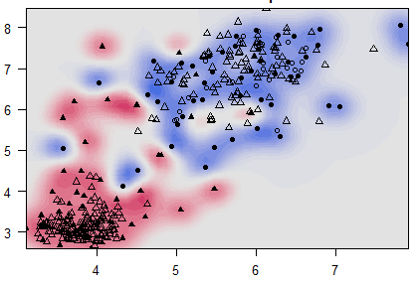
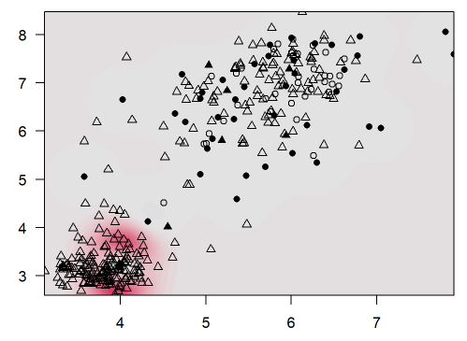
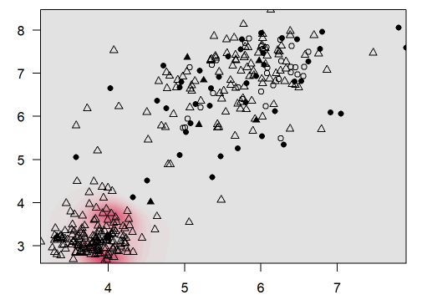
c=2
c=100000

Slide 27
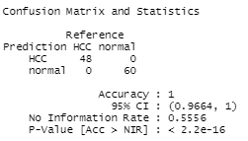
Large C -> more misclassifications (high bias) ;
less variability [Underfitting]
Small C -> less misclassifications (low bias) ;
high variability [Overfitting]
Radial kernel model with tuned cost parameter -> testing accuracy of 100%

Slide 28
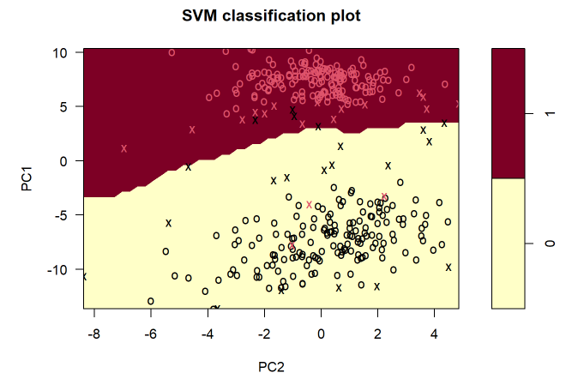
SVM on PCA

Slide 29
THANK YOU FOR YOUR ATTENTION

